Slide 1
More Murders, More Happiness
A presentation by Z. Bartel, professor in Murder Physics
Notes:
Seed: Murder Generator: Title slide Context: {'topic': 'Murder', 'presenter': 'Z. Bartel', 'seed': 'Murder', 'seed_plural_title': 'Murders', 'seed_title': 'Murder'} Generated Elements: ['More Murders, More Happiness', 'A presentation by Z. Bartel,\nprofessor in Murder Physics']

Slide 2
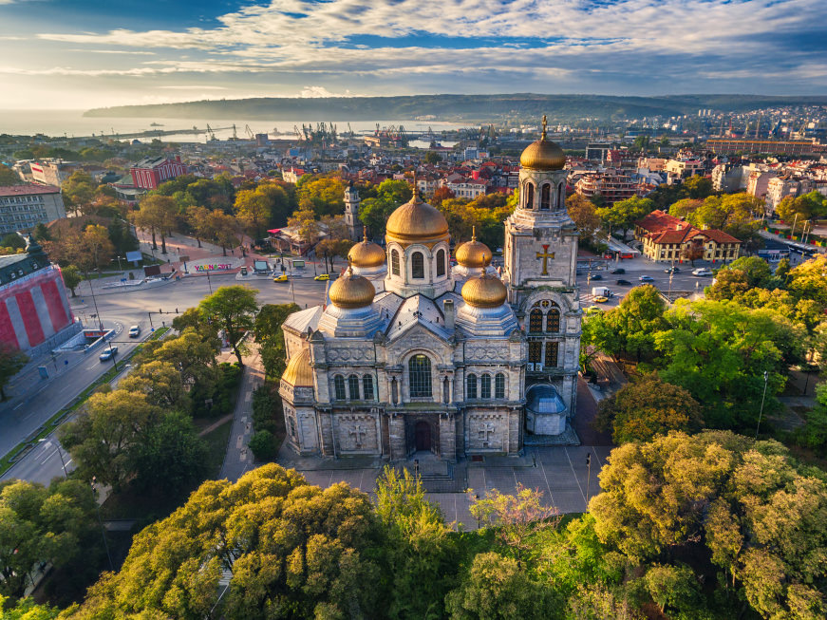
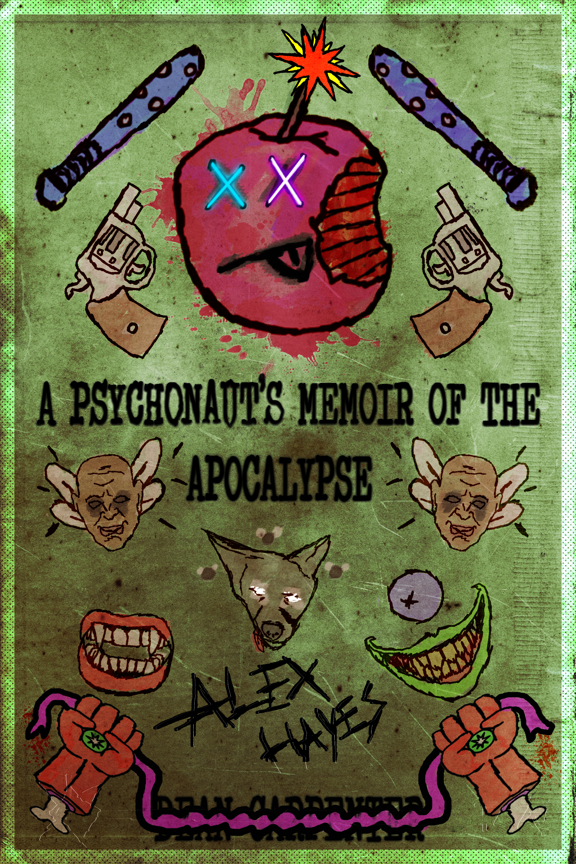
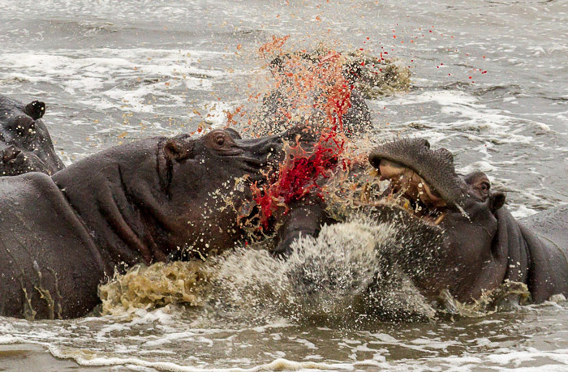
Personal background
Bulgaria
Recent Essay
Obsession
Notes:
Seed: Murder Generator: About Me: Location-Book-WeirdHobby Context: {'topic': 'Murder', 'presenter': 'Z. Bartel', 'seed': 'Murder'} Generated Elements: ('Personal background', 'Bulgaria', '/downloads/google_images/Bulgaria/bulgaria-the-cathedral-of-the-assumption-in-varna.jpg', 'Recent Essay', '/app/talkgenerator/schema/../../downloads/reddit/BookCovers+fakebookcovers+coverdesign+bookdesign/iovxxzbvg47z.png', 'Obsession', '/app/talkgenerator/schema/../../downloads/reddit/hmmm+hmm+wtf+wtfstockphotos+photoshopbattles+confusing_perspective+cursedimages+HybridAnimals+EyeBleach+natureismetal/jr5w7v4d6d2y.jpg', True)

Slide 3
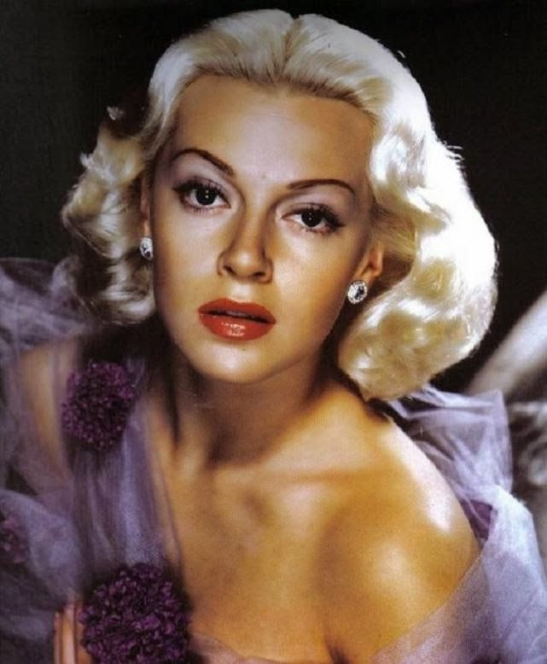
History of Murders
"He was my mum and dad's best friend. He's a convicted murderer, but he's broken out of wizard prison and he's on the run. He likes to keep in touch with me, though...keep up with my news...check if I'm happy..."
Master Lincoln Gilligan
Notes:
Seed: Murder Generator: Historical Figure Quote Context: {'topic': 'Murder', 'presenter': 'Z. Bartel', 'seed': 'Murder', 'seed_plural_title': 'Murders'} Generated Elements: ['History of Murders', 'Master Lincoln Gilligan', '/app/talkgenerator/schema/../../downloads/reddit/OldSchoolCool/6ff479cc24a75b2ad267e1254885e7dd.jpg', None, '"He was my mum and dad\'s best friend. He\'s a convicted murderer, but he\'s broken out of wizard prison and he\'s on the run. He likes to keep in touch with me, though...keep up with my news...check if I\'m happy..."', True]

Slide 4
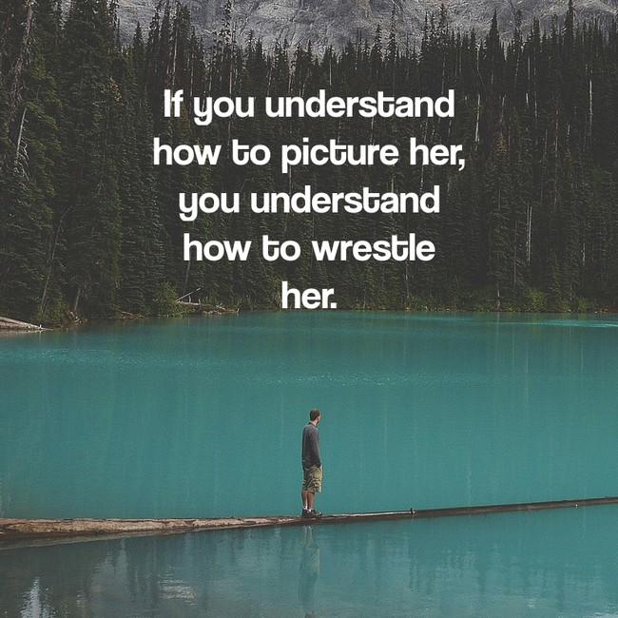
My grandma always said:
Notes:
Seed: Murder Generator: Inspirobot Context: {'topic': 'Murder', 'presenter': 'Z. Bartel', 'seed': 'Murder'} Generated Elements: ['My grandma always said:', '/app/talkgenerator/sources/../downloads/inspirobot/51-5035.jpg', True]

Slide 5
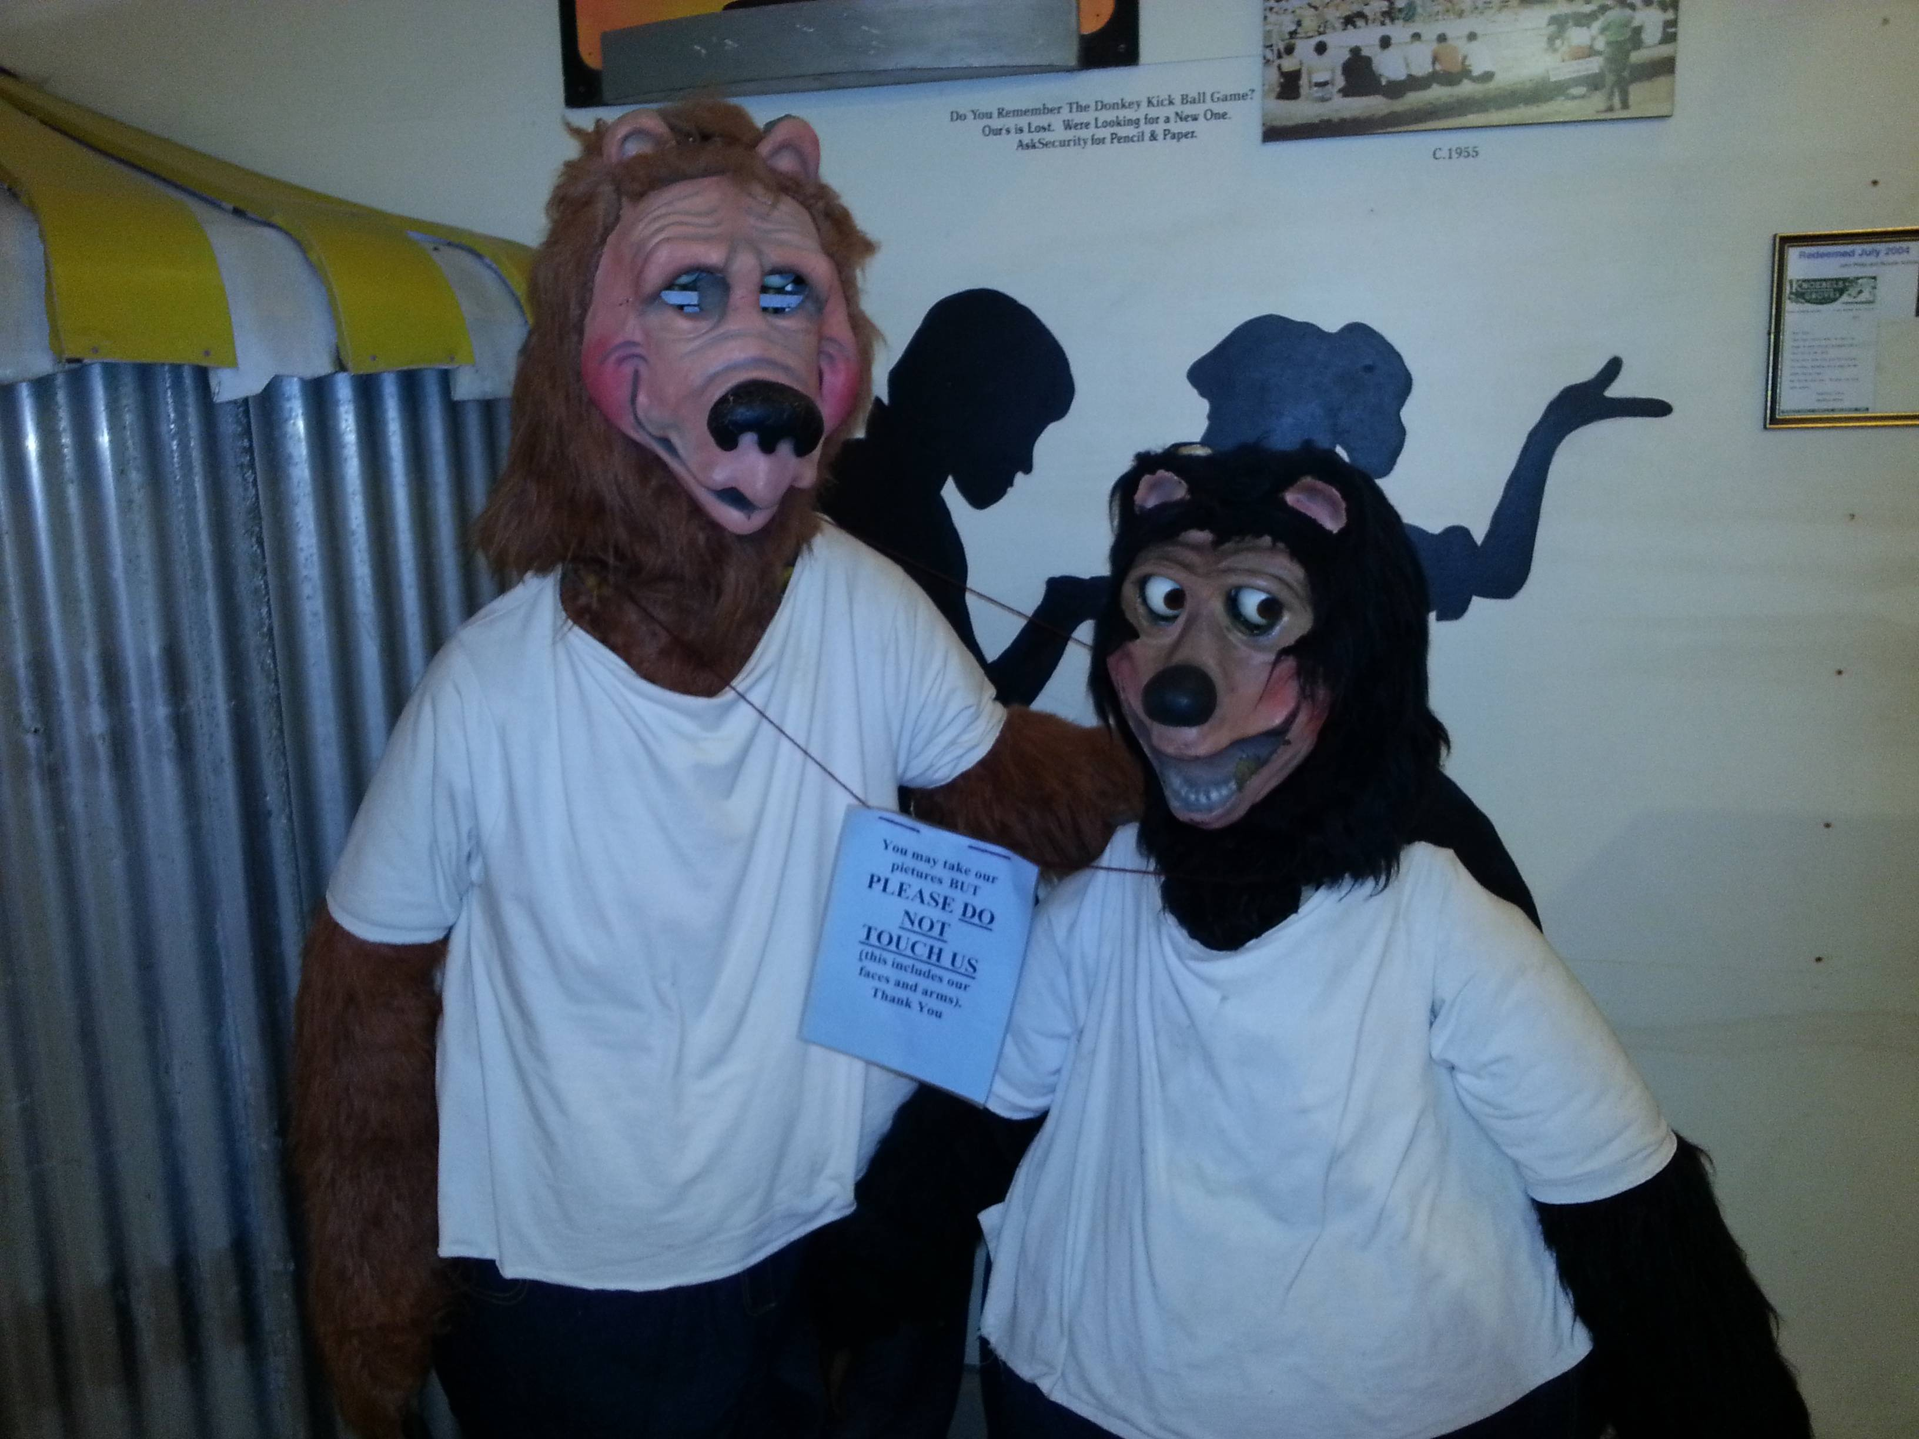
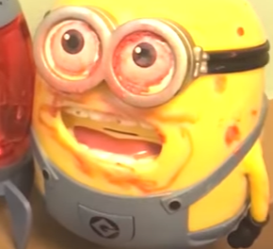
Murders
How I see Murders:
What Murders actually are:
Notes:
Seed: Murder Generator: Two Captions Weird Context: {'topic': 'Murder', 'presenter': 'Z. Bartel', 'seed': 'Murder', 'seed_plural': 'Murders', 'seed_plural_title': 'Murders'} Generated Elements: ('Murders', 'How I see Murders:', '/app/talkgenerator/schema/../../downloads/reddit/hmmm+hmm+wtf+wtfstockphotos+photoshopbattles+confusing_perspective+cursedimages+HybridAnimals+EyeBleach+natureismetal/DO6Nz.jpg', 'What Murders actually are:', '/app/talkgenerator/schema/../../downloads/shitpostbot/murderous-minion-5967cfc699173.png', True)

Slide 6
Let's look at Murders
Before
After
Notes:
Seed: Murder Generator: Two Captions Gifs Context: {'topic': 'Murder', 'presenter': 'Z. Bartel', 'seed': 'Murder', 'seed_is_noun_plural_title': 'Murders'} Generated Elements: ("Let's look at Murders", 'Before', '/app/talkgenerator/schema/../../downloads/reddit/gifs+gif+gifextra+nonononoYES/qHzKK5I.gif', 'After', '/app/talkgenerator/schema/../../downloads/reddit/gifs+gif+gifextra+nonononoYES/f04emrbqkr3x.gif', True)

Slide 7
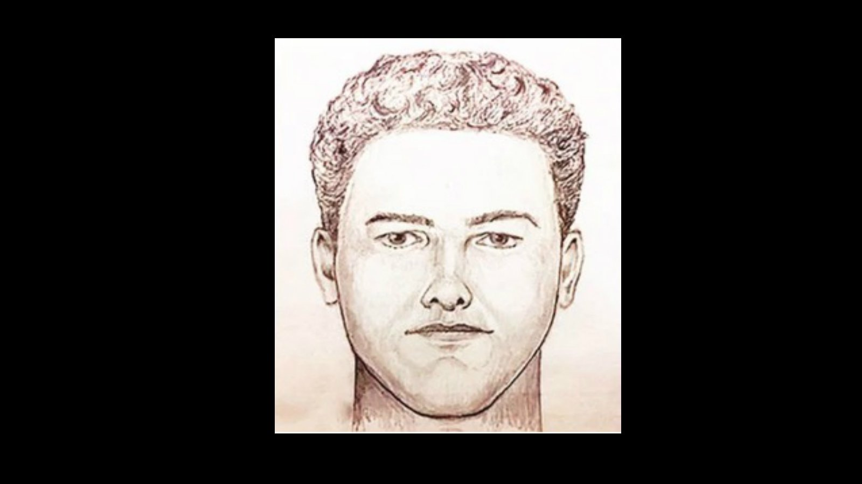
My Murder Accident
Notes:
Seed: Murder Generator: Anecdote Context: {'topic': 'Murder', 'presenter': 'Z. Bartel', 'seed': 'Murder', 'seed_title_dashes': 'Murder'} Generated Elements: [None, 'My Murder Accident', '/downloads/google_images/Murder/new-sketch-released-in-murder-investigation.jpg']

Slide 8

About Murders
Notes:
Seed: Murder Generator: Wide Google Images Context: {'topic': 'Murder', 'presenter': 'Z. Bartel', 'seed': 'Murder', 'seed_is_noun_plural_title': 'Murders'} Generated Elements: ['About Murders', '/downloads/google_images/Murder/murderrr.jpg', True]

Slide 9
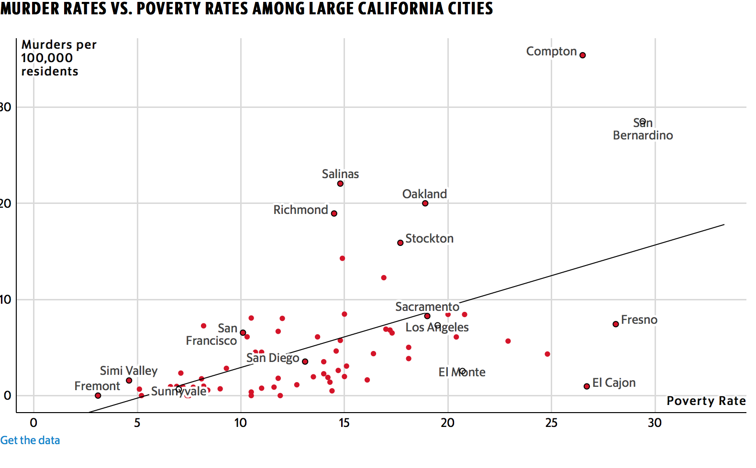
Notes:
Seed: Murder Generator: Reddit Chart Context: {'topic': 'Murder', 'presenter': 'Z. Bartel', 'seed': 'Murder', 'seed_plural_lower': 'murders', 'chart_title': 'Places you will find murders'} Generated Elements: [None, '/app/talkgenerator/schema/../../downloads/reddit/dataisbeautiful+funnycharts+charts/ax9c5mtd9puz.png', True]

Slide 10
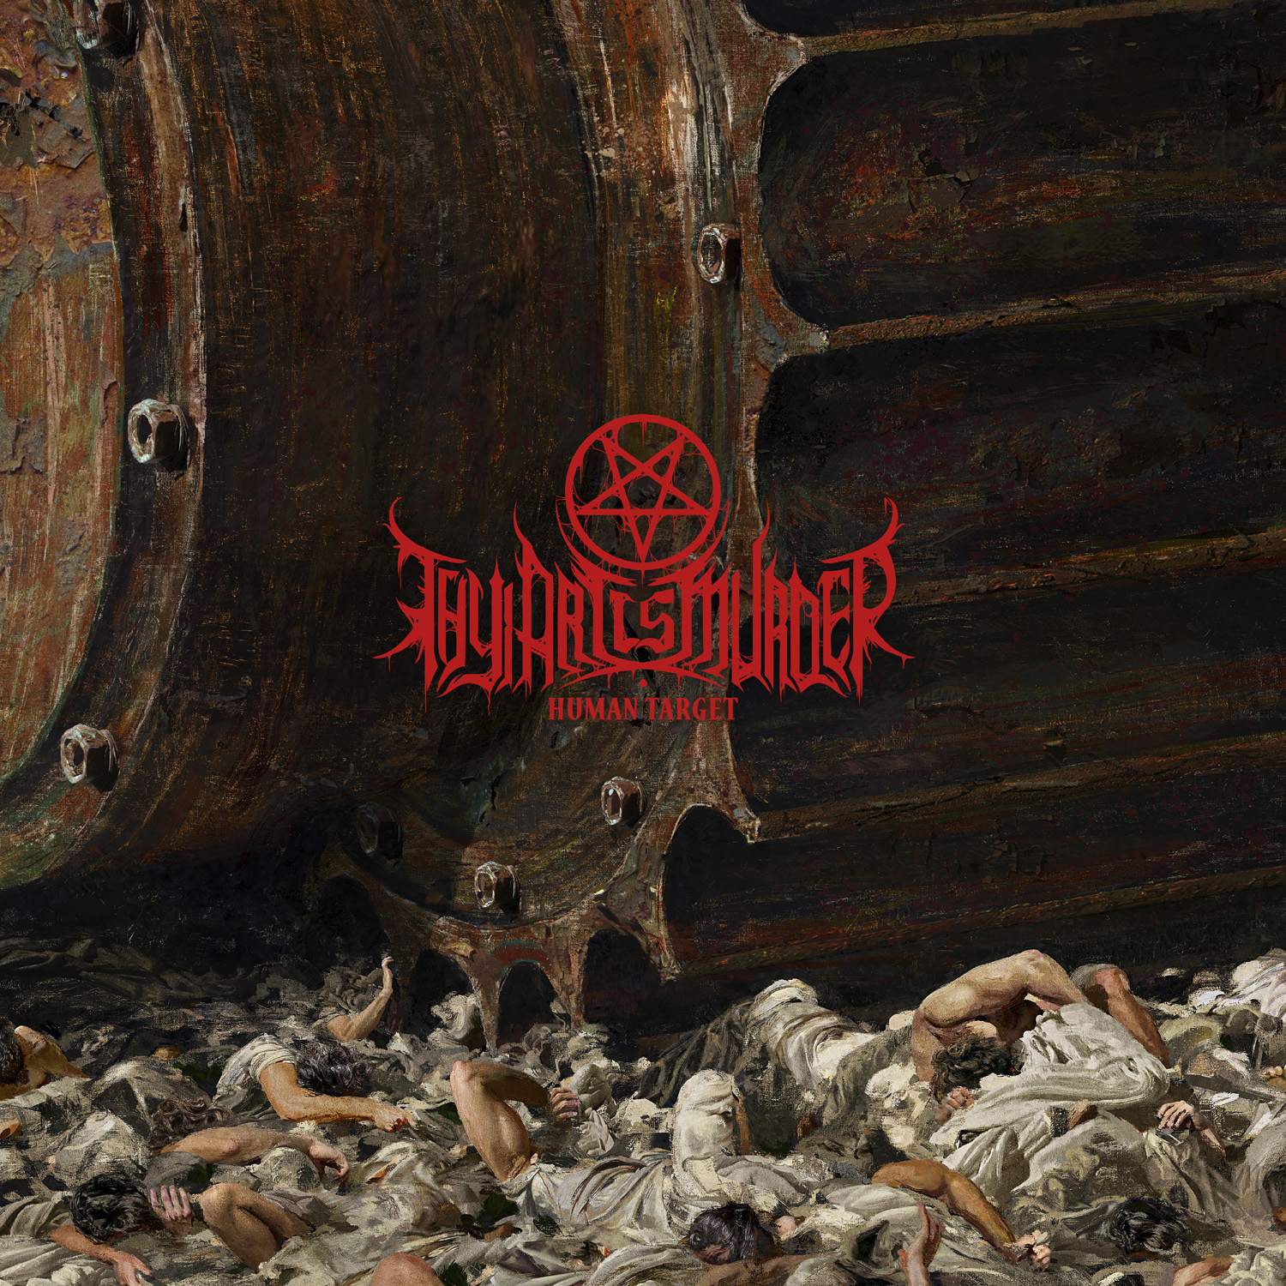
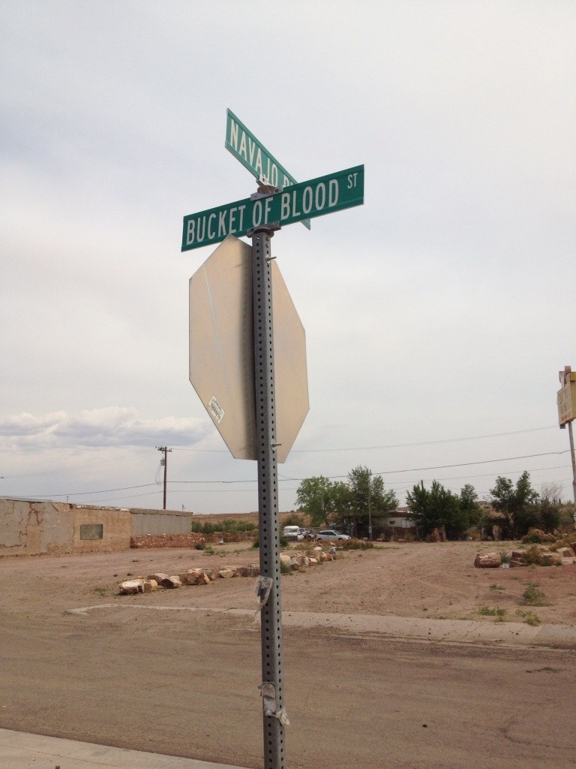
Ending Points
Conclusion 1
Conclusion 2
Notes:
Seed: Murder Generator: Conclusion Context: {'topic': 'Murder', 'presenter': 'Z. Bartel', 'seed': 'Murder'} Generated Elements: ['Ending Points', 'Conclusion 1', '/downloads/google_images/Murder/thy-art-is-murder-human-target.jpg', 'Conclusion 2', '/app/talkgenerator/schema/../../downloads/reddit/hmmm+hmm+wtf+wtfstockphotos+photoshopbattles+confusing_perspective+cursedimages+HybridAnimals+EyeBleach+natureismetal/peJiv78.jpg', True]

